Slide 1
Group 6:
Image Filtering
Aurojit Chakraborty, Daniellia Sumigar, Dylan Ramdhan, Ellen Burhansjah, Ian Lee, Minh Nguyen, Xinglin He

Slide 2
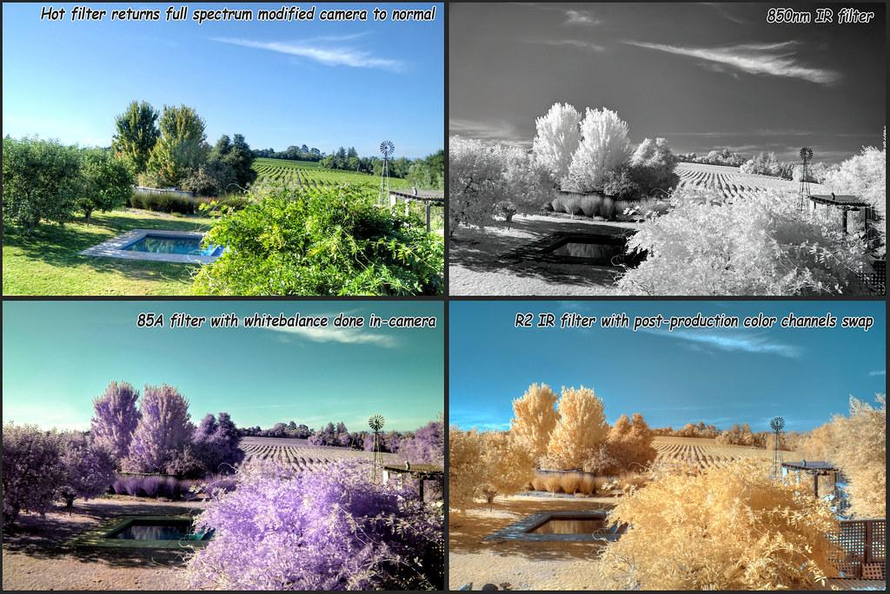
Description
In this project, we were tasked to build a user-friendly application that allows the user to implement various filters to an existing image of the user’s choice.

Slide 3
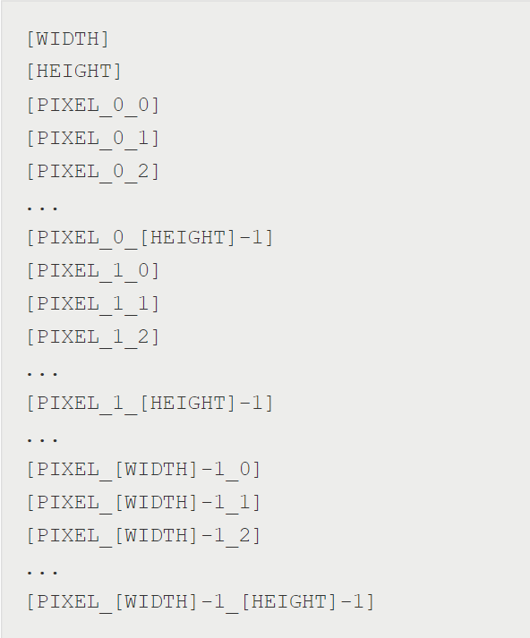
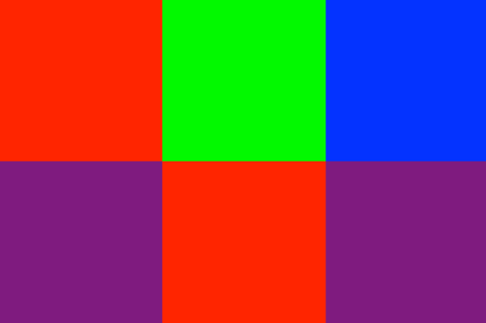
Minimum Requirements
Display image on screen
Check if the user upload a text file in the right format.
Upload text file - Text file must be in specified format to be converted into image
Zero out green and blue components of pixels

Slide 4
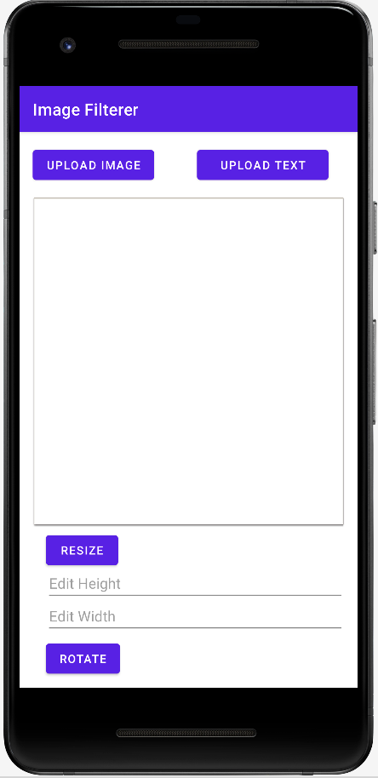
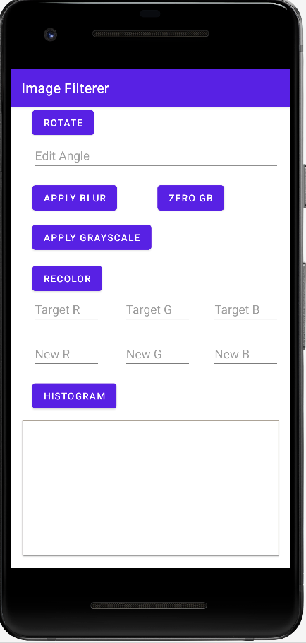
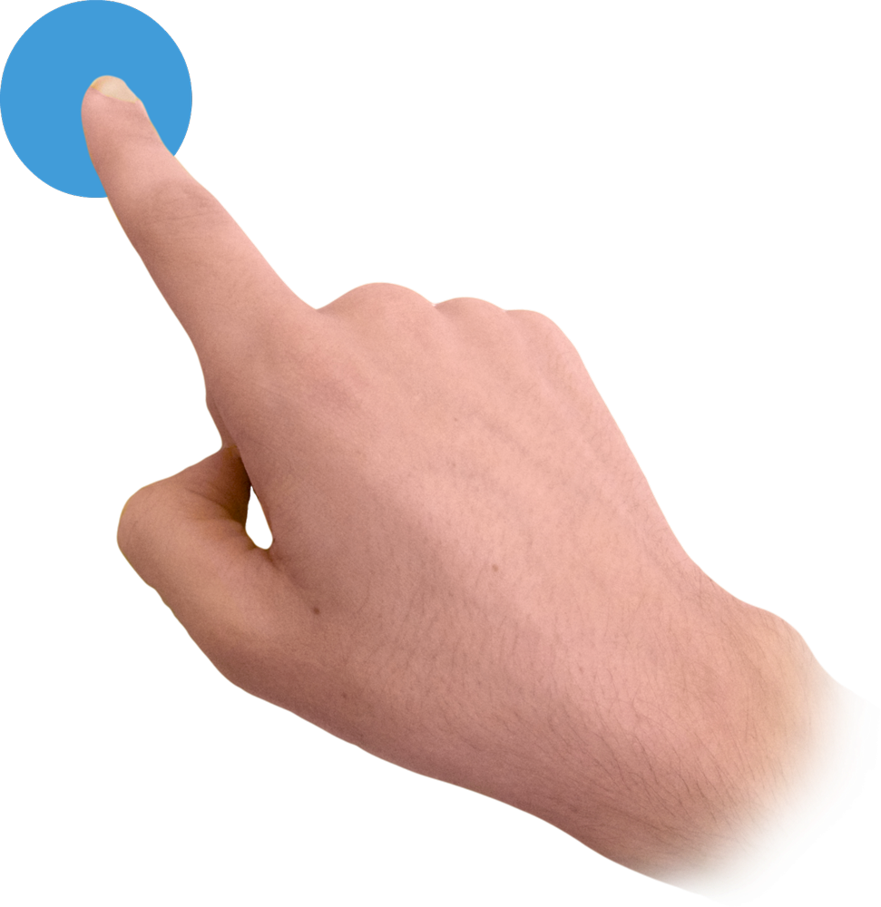
Design Decisions
Layout after scrolling:
Scrolling layout for a better user experience.
Separated the upload image and upload text features into two different buttons.
Displayed text based buttons for user-specified inputs.
Implementing toast for error checking.

Slide 5
Challenges
1) Rotate button
Whenever the user clicks onto the rotate button multiple times, the rotated image will decrease in size upon each clicks. We suspect that the problem lies upon how whenever the rotated image goes beyond the range of the imageView, the image gets automatically modified; hence, decreasing in size for each rotation.

Slide 6
Additional Features
Rotate
Rotate image by user-specified angle
Recolor
Change one color of image to another color
Resize
Grow/shrink image by user-specified factor
Apply Blur
Adds blur to the image
Zero GB
Zeroes Green and Blue components of pixels in the image
Grayscale
Display the average RGB components of pixels in the image
Histogram
Display a histogram of the colors present in the pixels of the image

Slide 7
Features in Action:

Slide 8
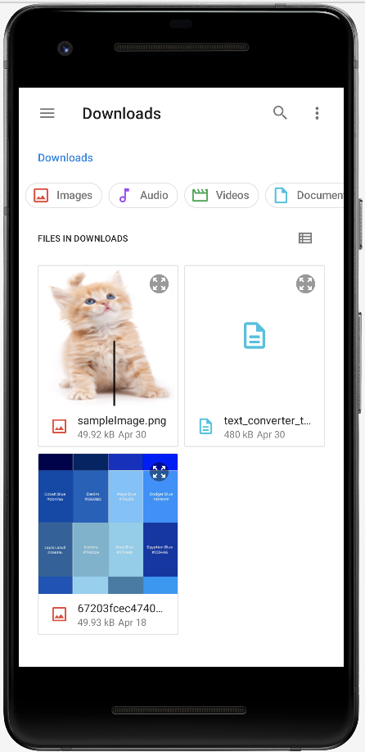
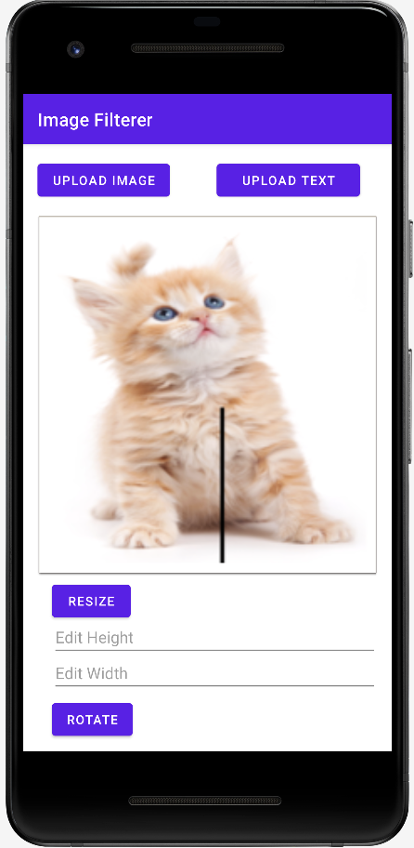
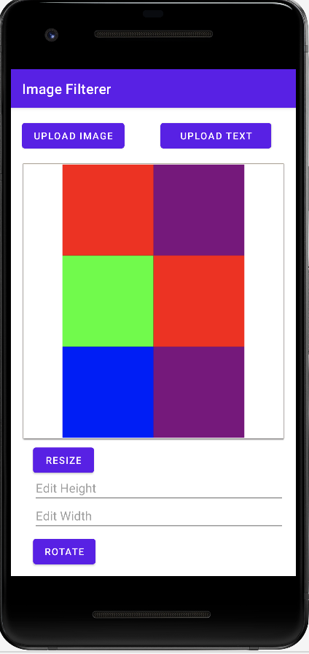
Upload Image & Upload Text Button
Copy image / text file by dragging onto the emulator. They are stored in Downloads folder
2) Click Upload Image Button > Click on desired image e.g. sampleImage.png
3) Click Upload Text Button > Click on desired text file e.g. text_converter_test.txt

Slide 9
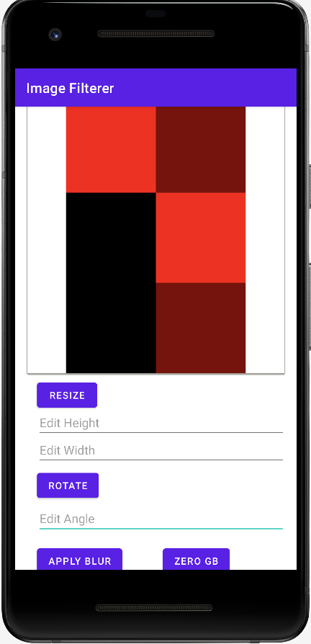
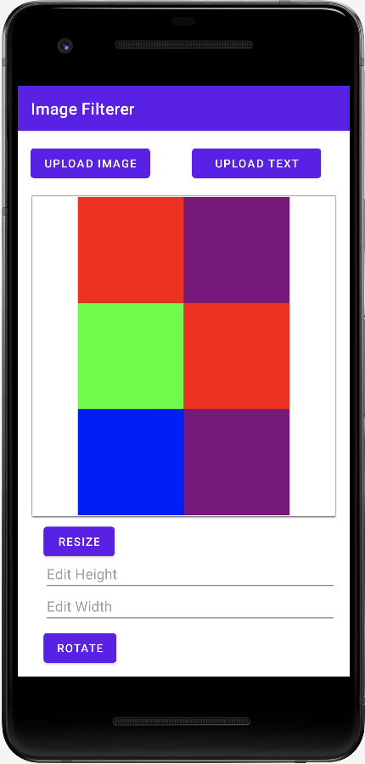
Zero GB
Upload desired image e.g. text_converter_test.txt
2) Click on the zeroGB button
Description:
when Zero GB is clicked, it zeros out green and blue pixels, turning an image red.

Slide 10
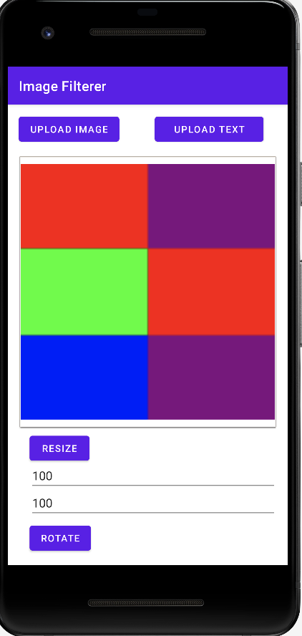
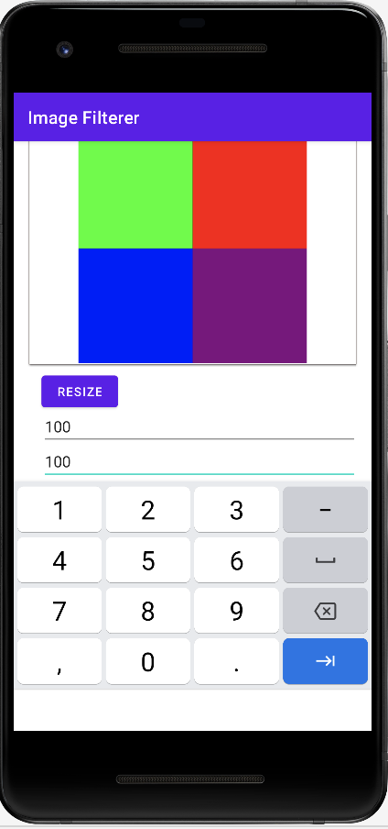
Resize image
Enter resizing factors in Edit Height and Edit Width
2) Click on the Resize button
Note:
When a user shrinks an image, it will appear blurred. This is because shrunken image has been compressed and stretched to fit the dimensions of the imageView.

Slide 11
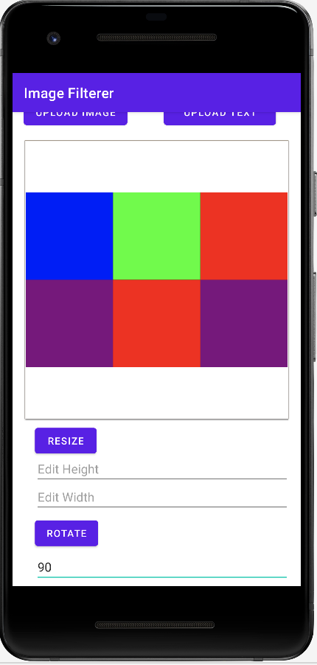
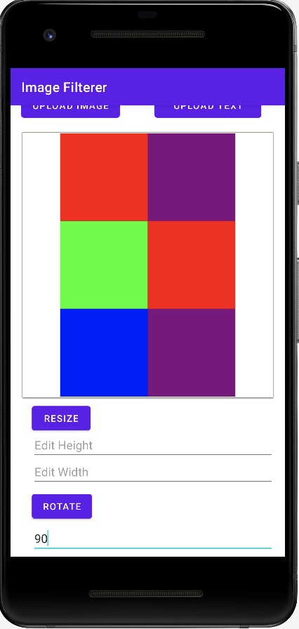
Rotate Image
Enter desired angle input in Edit Angle e.g. 90
2) Click on the Rotate button

Slide 12
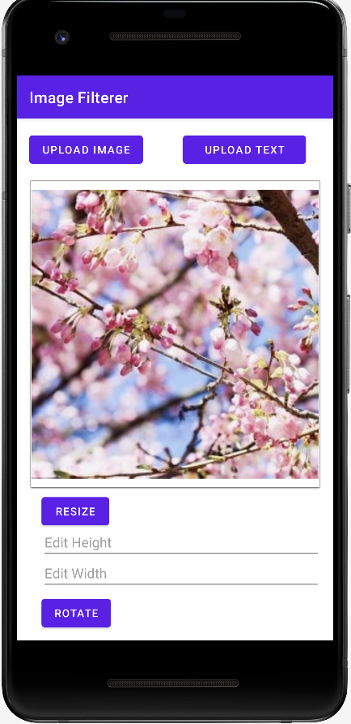
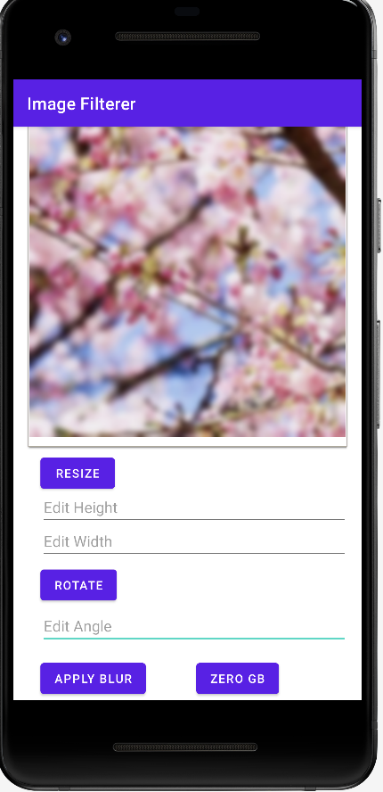
Blur image
Upload desired image e.g. blur.jpeg
2) Click on the Apply Blur button

Slide 13
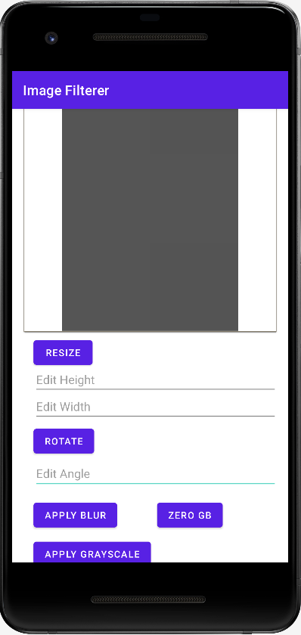
Grayscale
Upload desired image e.g. text_converter_test.txt
2) Click on the Apply Grayscale button

Slide 14
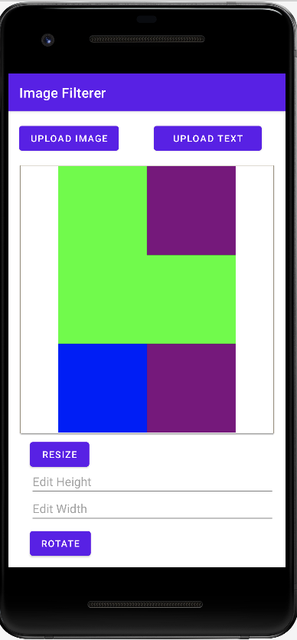
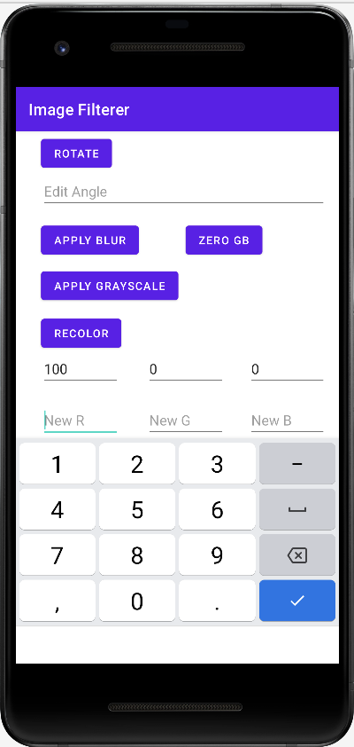
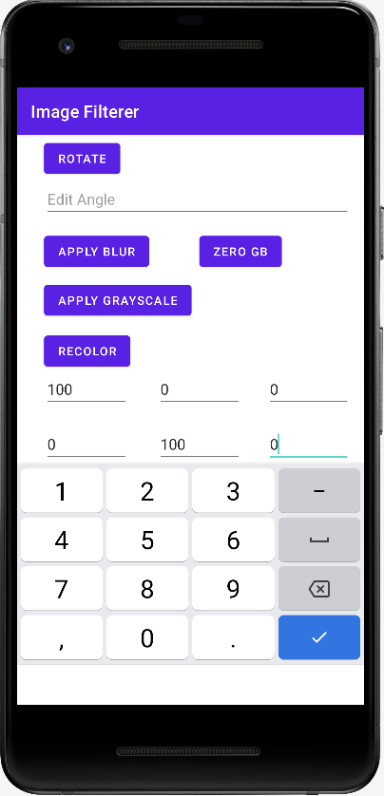
Recolor Image
Note: Values entered must be 0 to 100 inclusive
Enter target colors at their respective text boxes: Target R, Target G, Target B e.g. 100 0 0
2) Enter new colors at their respective text boxes: New R, New G, New B e.g. 0 100 0
3) Click on Recolor Button
Before recolor
After recolor

Slide 15
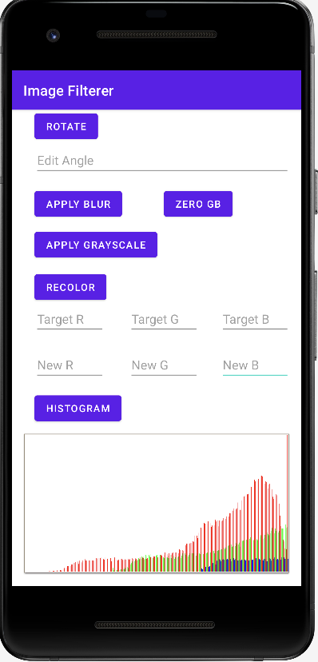
Histogram
Upload desired image e.g. blur.jpeg
2) Click on the Apply Histogram button

Slide 16
Execution
Project Source
Link to the repo: https://agile.bu.edu/gitlab/ec327_projects/group6project.git
Installation
Click onto the repo link to clone required files onto the computer.
Open AndroidStudio and open the cloned folder.
Allow build.gradle to complete and configure the device to be Pixel 2A API 30 (Create Device > Pixel 2 > R).
Click on the run button to see the App in action.
For more information, please refer to README.md in project source repo.

Slide 17


